Slide 1
MAP Testing MEASUREs OF ACADEMIC PROGRESS December 9, 2014

Slide 2
MAP Testing & why we use it…
The NWEA Measures of Academic Progress are computerized, adaptive tests of Reading, Language, Mathematics and Science for students in Grades 2-10 taken in Fall and Spring.
The tests are based on a continuous scale, independent of age or grade, allowing us to track student growth and performance trends over time.
The adaptive nature of the tests helps teachers pinpoint optimal instructional levels for students. The system adjusts giving each student a unique test.
As students respond correctly, they are given questions and material that become more challenging; as they respond incorrectly, the material becomes easier.
Notes:
MAP stands for Measure of Academic Progress. The tests are computerized and adaptive in Language, Reading and Mathematics. As students respond correctly they are given questions that become more challenging as students respond incorrectly the material becomes easier.

Slide 3
How the results are used
NWEA tests are primarily tools to assist teachers in their instruction. Specifically, teachers use these tests to help:
Understand the diversity of academic ability and achievement in their classes.
Identify students at risk of not achieving grade-level proficiency.
Plan for differentiated instruction that addresses all students’ learning needs.
Monitor the progress of selected students or groups throughout the year.
Evaluate their success with their classes.
Notes:
Teachers at GEMS American Academy use the MAP tests to help identify academic ability, monitoring of progress and to plan for differentiated instruction to meet the needs of all students.

Slide 4
What is RIT?
An equal-interval scale used to measure achievement and growth over time
Rasch Units start at 100 (Rasch unIT = RIT)
Direct relation to content in each subject area
Similar to centimeters or inches
Georg Rasch was a Danish mathematician, statistician and psychometrician, most famous for the development of a class of measurement models known as Rasch models.

Slide 5
Understanding the results
Student Score Range
The middle number is the RIT score your child received. The numbers on either side define the score range. If retested, your child would score within the range most of the time.
District Average RIT
This is the average score of students in the same grade taking the same test at GAA
Norm Group Average
This is the average score of students at that same grade level taking the same test in the United States.
Notes:
Season/Year – Depending on how long your child has been in the school determines how many tests there are. This allows you to track your child's growth over time.
Student Score Range – the number highlighted in bold is the RIT (Rasch Unit) score and reflects the level at which your child is currently performing. Because no score is absolute the score range indicates if the student took the test again their score would fall into this range.
What is the RIT score?
The RIT score is short for Rausch Unit. The RIT scale is consistent; one RIT is always one RIT. For example a student who grows from 165-170 has the same amount of instruction growth as a student who grows from 280 – 285 – 5 RIT points of growth
District Average – This shows the average score of students who have taken this test in the school.
Norm Group Average – This shows the average score of students who have taken this test in the US.

Slide 6
Understanding the results
Student Growth*
Growth in RITs your child has made from Fall to Spring.
Typical Growth*
The average growth in RITs across students in the United States.
*appear at the end of one whole testing year
Growth is also visible on the graph on the back
Goal performance – each goal area included in the test is listed.
Notes:
Student Growth – This shows the instructional growth over one year
Typical Growth – every child is unique but from NWEA’s norm study an average is taken to get an idea for how much RIT growth a student might show over a year.
These only appear at the end of one whole testing year – you will get these results after the Spring MAP tests.
Student Percentile Range – this tells you how your child is doing compared to other students in the same grade. For example, if your 7th grader has a percentile score of 81 in reading, your child is equal to or better than 81% of 7th graders who have taken the MAP test.

Slide 7
Understanding the results
Student Percentile Range
Your child scored as well as or better than this percentage of students taking the test in his or her grade level. So in W12, 61% scored 233 or less. If retested, your child’s percentile rank would be within this range most of the time.
This is not the same as percentage
on a traditional test.
Goal Performance
Low <21 percentile
LoAvg 21-40 percentile
Avg 41-60 percentile
HiAvg 61 -80 percentile
High >80 percentile
Notes:
Student Growth – This shows the instructional growth over one year
Typical Growth – every child is unique but from NWEA’s norm study an average is taken to get an idea for how much RIT growth a student might show over a year.
These only appear at the end of one whole testing year – you will get these results after the Spring MAP tests.
Student Percentile Range – this tells you how your child is doing compared to other students in the same grade. For example, if your 7th grader has a percentile score of 81 in reading, your child is equal to or better than 81% of 7th graders who have taken the MAP test.

Slide 8
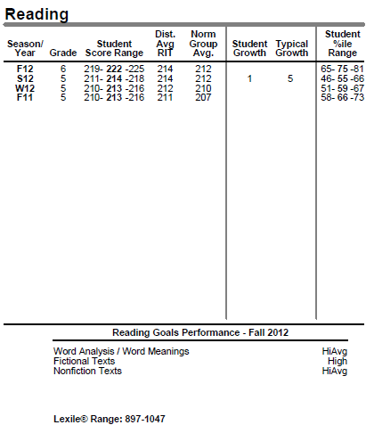
Understanding the results
Goals Performance strands
Strength and weakness in specific content areas
Lexile® Range
The difficulty range of text that can be understood by the student 75% of the time. Most books in the library include the Lexile number.
Notes:
Goal Performance – Each MAP is made up of parts, called ‘goal areas’ you can use this to see if your child has stronger of weaker areas.
Lexile Range – The Lexile score gives you some additional information about your child’s reading and this score relates to varying difficulty level of books.

Slide 9
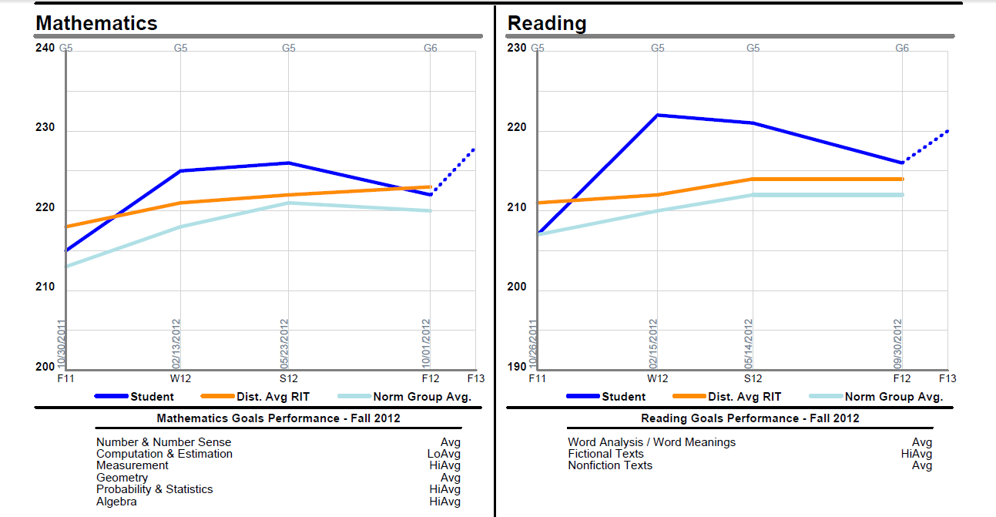
Notes:
The graphs on the back show student growth (blue) compared to the international (orange) and US (light blue) norms.
Below the graphs, the student’s strengths in the different strands are listed.

Slide 10
What if there is an area of low achievement?
All people have areas of strengths and weakness
This could be a section of the curriculum that has yet to be taught
Look for ways to practice

Slide 11
Notes:
Some sample ideas to encourage continued achievement and progress in reading. More can be found in the parent tool kit on www.nwea.org

Slide 12
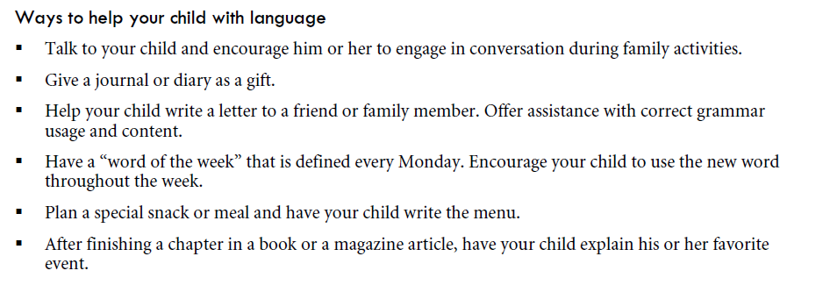
Notes:
Some sample ideas to encourage continued achievement and progress in language use. More can be found in the parent tool kit on www.nwea.org

Slide 13
Notes:
Some sample ideas to encourage continued achievement and progress in mathematics. More can be found in the parent tool kit on www.nwea.org

Slide 14
Examples of questions
The Math and language tests have 52 questions, Reading 42 and Science 45.
Here are some examples:

Slide 18
Language & Reading Websites
www.scholastic.com Reading Egg to learn & practice reading skills
www.lexile.com Lexile framework Select reading material according to Lexile and interests
www.funbrain.com Games
www.raz-kids.com Reading
http://www.brainpopesl.com/ ESL username: gemsaaad
password: abudhabi
Notes:
Suggested websites to stimulate student growth in reading and language usage

Slide 19
Math Websites
www.aaamath.com Practice & activities
www.coolmath.com Interactive games
www.mathisfun.com Background information & practice
www.mathletics.com For Grades 1-5
www.khanacademy.com For Grades 6 and up: video tutorials and interactive practice
Notes:
Suggested websites for mathematics

Slide 20
Science Websites
http://www.brainpop.co.uk
and for juniors http://www.brainpopjr.com
Username: gemsaaad Password: abudhabi for both

Slide 21
Thank you!
You will be receiving your child’s MAP results this week
Thank you for coming this
morning

