Slide 1
The PYP Exhibition
Parent Information

Slide 2
What is it?
The Exhibition is:
an individual, group or whole class inquiry
an inquiry that starts from personal interest and passions, but extends into real world local and global issues
an inquiry that requires students to apply their learning from previous years

Slide 3
Non negotiable features…
The subject of the inquiry must be a real world issue.
Students must be involved in all stages of planning:
the issue
the learning outcomes
the activities
the assessment.
The Exhibition should include:
examples of written work
oral presentations
examples of technology
performances in any medium – dance, drama, film, video, mixed media.

Slide 4
Non negotiable features continued…
Students must show an understanding of the main concepts: form, function, causation, change, connection, perspective, responsibility, reflection.
Students must use skills from all 5 areas: social, research, self management, communication, thinking.
Students must show positive attitudes: appreciation, commitment, confidence, cooperation, creativity, confidence, curiosity, empathy, enthusiasm, independence, integrity, respect, tolerance.

Slide 5
How much time do students spend working on the Exhibition?
The students will start brainstorming issues, ideas and thinking about concepts.
The students will spend about 8 weeks working on their inquiries in March, April, May (Exhibition Evening mid May 2015)
The students will continue to have math, and specialist classes during the Exhibition time, but the majority of each day will be used working on inquiries.

Slide 6
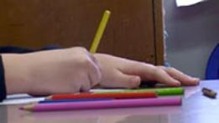
What about homework?
The children will have less homework during this time.
Some homework for some subjects may be given each week.
The children should use their time at home to research, reflect and prepare for the work in class.

Slide 7
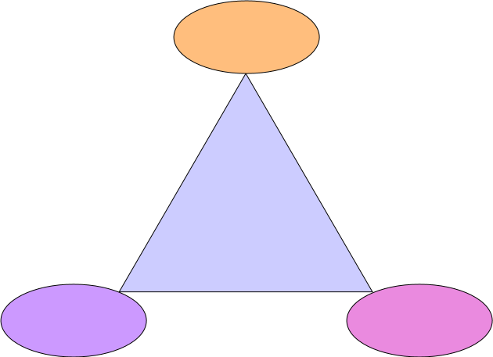
The role of parents
Mentor
Student
or
Group
Parents
Teacher

Slide 8
How can parents help?
Parents can:
keep informed about the process by visiting the Launcher website, reading newsletters and attending meetings
support and encourage their children, read reflections at home
provide knowledge or areas of expertise to any of the groups.
help to locate resources – people, places, media and information
Celebrate with the students by attending the
final presentations.

Slide 9
How do we mark students work?
“Exhibitions are the best way to measure learning because they put the kids right in the midst of their learning” Dennis Littky
We assess the process more than the product.
The students should keep a journal throughout exhibition that shows how their thinking and goals have developed.
This journal may include pictures, diagrams, poems, timelines and writing.
The mentors keep a record of student progress against a timeline.

Slide 10
Rubrics
The Rubric will cover the 5 Essential Elements ie:
Skills
Knowledge
Concepts
Learner Profile
Action

Slide 11
Who will mark the work?
Children will self assess and peer assess using the rubrics.
The class teacher will also use the rubrics to assess.
Visitors from the school community will also provide feedback

Slide 12
Something for us all to remember…
As with any inquiry there will be times when it seems that students are not being very productive.
Sometimes there will be lot of discussion and thought but this will not result in anything that can be seen.
Students (and adults) need time and space to wonder about things and consider their plans.
This is why we place so much emphasis on the process journals. They will show the understanding of concepts and application of skills (e.g. problem solving) more than the final product.

Slide 13
Questions?
Please feel free to ask any questions

