Slide 1
Understanding the NWEA MAP Reports

Slide 2
What are MAP tests?
Measures of Academic Progress
Twice a year in Fall and Spring
Grades 2 – 10
Reading – Language Usage – Mathematics – Science
Web-Based
Un-timed, but tends to take 35 – 60 minutes
42-52 questions
Based on AERO Standards
UNIQUE: adapts to student performance during test

Slide 3
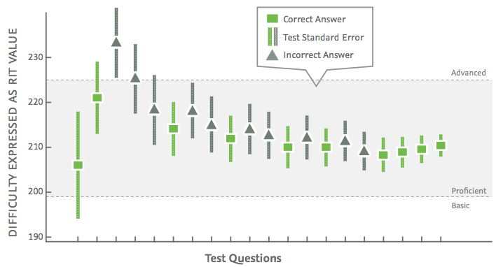
UNIQUE: Adaptive Tests

Slide 4
MAP is not a grade or an evaluation; not part of our report cards or transcripts
One snapshot used with multiple other forms of information about your child
Can confirm teacher understanding of child or provoke teacher to ask questions
Most important is knowing your child
One snapshot of a child, class, grade level, and overall school performance
Opportunity to measure growth over time
Examine subtopics related to each area for needs for instructional purposes
Follow cohorts at GAA to inform curriculum
Compare GAA to international averages (norms)

Slide 5
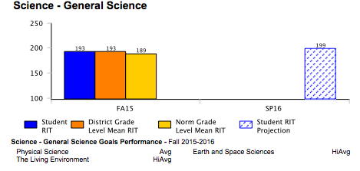
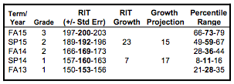
Reading your child’s report...
When looking at your child’s achievement (RIT score or percentile),
remember, this was one untimed test on one day…
Consider fatigue, the testing environment, and potential difficulties remaining focused at a computer for long periods of time

Slide 6
Fall Focus: Reporting Achievement
RIT
Rasch unIT: Measurement scale of equal intervals
Achievement scale used to show growth over time
Independent of grade level; RIT score linked to level of item difficulty
Not “out of”

Slide 7
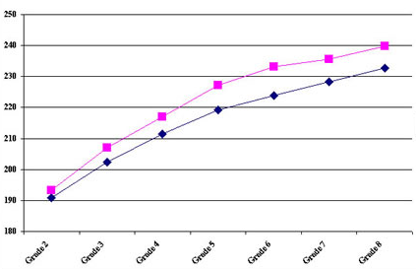
Fall Focus: Reporting Achievement (RIT)
Relate directly to the curriculum scale in each subject area.
It is an equal-interval scale, like feet and inches,
RIT scores range from about 100 to 300+.
Students typically start at the 180 to 200 level in the third grade and progress to the 220 to 260 level by high school.
Well-researched RIT correlations indicate that most students are ready to learn Algebra once they achieve 235 or more in mathematics, and Geometry at a RIT of 245.

Slide 8
Fall Focus: Reporting Achievement
Percentile
Compare one student to the norm group.
Means student scored as well as or better than that percent of students taking the test.
In other words, a student with 73 %ile scored as well as or better than 73% of all students in the norm group.
68% chance the student’s percentile ranking would be in this range if tested again soon.

Slide 9
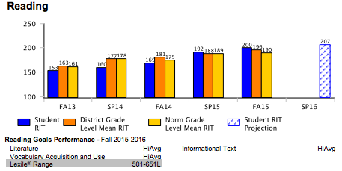
Fall Focus: Reporting Achievement (Lexile)
helps identify an appropriate level of reading material
measures syntactic complexity - the number of words per sentence, and semantic difficulty - the frequency of words in a text
does not measure genre, theme, content, or interest

Slide 10
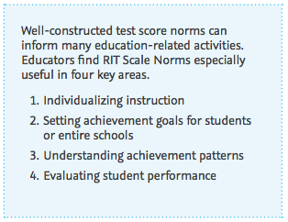
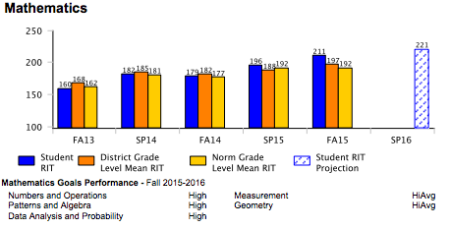
Why use MAP?
Measure and report student achievement and growth over time in Language Usage, Reading, Mathematics, and Science
Provide additional information to help set learning goals

Slide 11
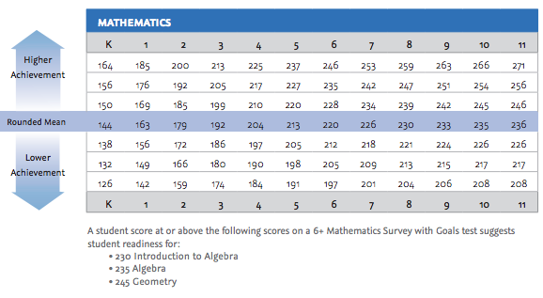
WHY USE MAP? Readiness, Predicting & Considerations for Placement

Slide 12
WHY USE MAP? Comparative Data to Inform Instructional Decisions
While not intended for use as a single placement guide, these data can help inform a variety of programmatic and instructional decisions, including:
identifying and qualifying students for various instructional strategies
guiding teachers on instructional program choices for students
scheduling and grouping to meet students’ learning needs
screening for special or alternative instruction
placement in consideration with teacher recommendation, past school marks, and other assessments
staffing and resourcing

Slide 13
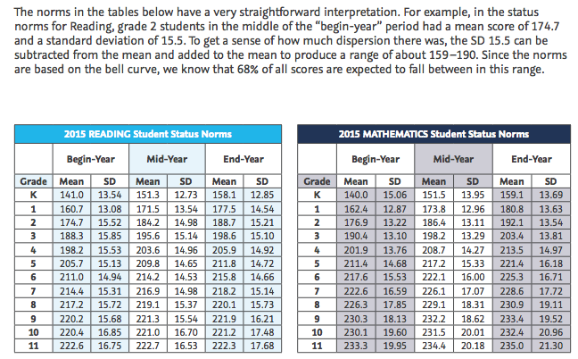
NWEA Norms

Slide 14
AIMING FOR GROWTH:
Purpose of MAP Testing
You may have a chart in your home on which you mark your child’s height at certain times, such as on his or her birthday. This is a growth chart. It shows how much he or she has grown from one year to the next.
MAP® assessments do the same sort of thing, except they measure your child’s growth in mathematics, reading, language usage, and science skills.

Slide 15
Growth Goals
Growth RIT scores make it possible to follow a student’s educational growth from year to year. The higher one gets in RIT the amount of growth over time will become less.
All growth, no matter the amount, is celebrated.
Projected RIT and Projected Growth
The projected RIT score and projected growth are based on the student’s actual RIT score in the Fall and the average RIT growth of students who were in the same grade and tested in the same term.

Slide 16
Fall Focus: Setting Goals (Teachers)

Slide 17
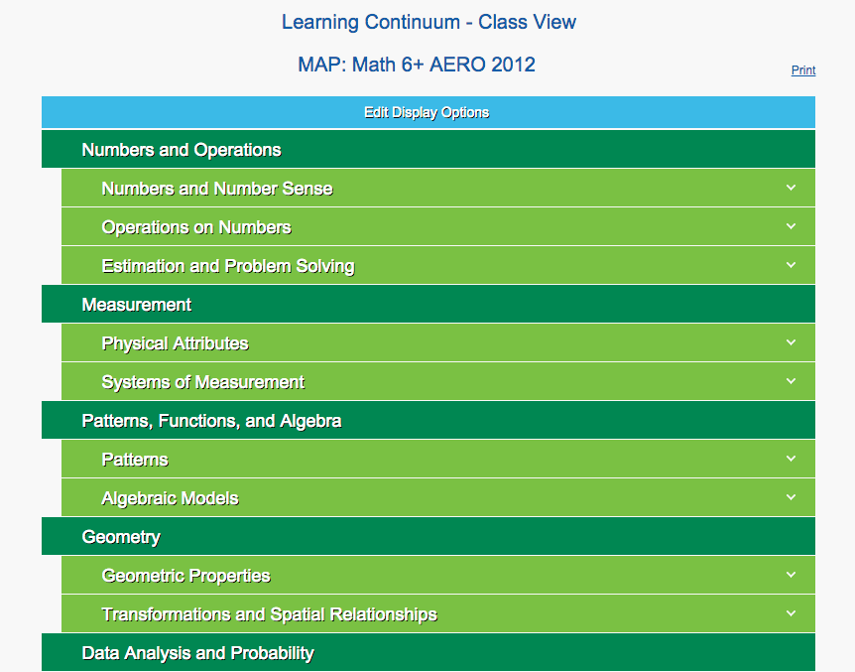
Goals/
Continuum

Slide 18
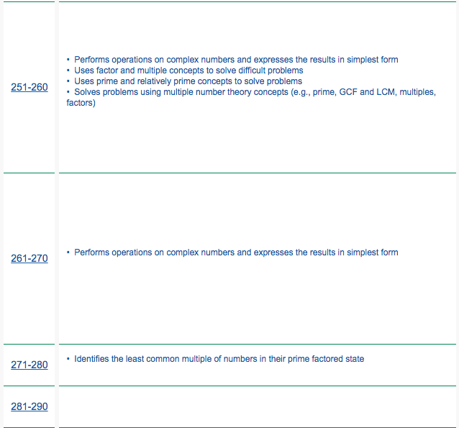
Goals/ Continuum
This tool is meant for teachers only -
Parents wishing to help their child grow can gain ideas from the NWEA Parent Toolkit and from the following slides, or discuss areas to target with their child’s teacher.

Slide 19
Fall Focus: Setting Goals (Student & Parent)

Slide 20
Helpful Hints for Growth
Explore, Play, Read, Write
Play board games like Monopoly, chess, Scrabble, Scattergories, etc.
Encourage journal writing.
Read magazines and newspapers together - look for new words and use of mathematics like graphs or statistics.
Read out loud to your child regardless of age or reading skill.
Have your child help with cooking using a recipe, planning a trip, shopping, building a bookshelf or garden.
Watch National Geographic, “Wild But True”, “Magic School Bus”, “Bill Nye”, “Mythbusters”, etc.
Go to a science museum or zoo, or a nature reserve/ conservation park.
Explain how you budget, and how you tip at restaurants.
Visit our library frequently. Help your child find books that are interesting to him/ her

Slide 21
Mathematics Websites
· www.ixl.com - online practice
· www.khanacademy.com - online tutorials and practice for older students
· www.mathisfun.com - information and quizzes
· www.kutasoftware.com - free worksheets for Pre-Algebra and up
· www.aaamath.com - Math practice and activities
· www.coolmath.com - Interactive math games
· www.funbrain.com - Great site for kids

Slide 22
Language & Reading Websites
· www.razkids.com
· www.funbrain.com - Language Arts games and more
· www.vocabulary.com - Vocabulary activities
· www.superkids.com/aweb/tools/words - Vocabulary builders
· www.lexile.com - Lexile Framework® for Reading Parent Toolkit

Slide 23
Science Websites
http://www.science-sparks.com/2013/04/27/kitchen-science-round-up/ - Kitchen science experiments
http://www.exploratorium.edu/snacks/ - DIY science explorations
https://sciencebob.com/ - videos, experiments, and more
http://www.physicsclassroom.com/ - tutorials, practice and simulations
https://www.brainpop.com/ - animated mini-movies (only 1/day is free)
http://billnye.com/ - Bill Nye the science guy
http://www.nwf.org/Kids.aspx - Ranger Rick online (games and more)
http://www.pbs.org/wgbh/nova/ - videos from pbs
http://www.ftexploring.com/ - information about energy in the world around us

Slide 24
Thank you
Sample Test: http://warmup.nwea.org/warmup_start_educators_map.html
For more information about NWEA MAP tests: https://www.nwea.org/assessments/map/
NWEA MAP Parent Toolkit: https://www.nwea.org/content/uploads/2014/07/ParentToolkit_0.pdf
Grade level normative data (median RIT scores and expected growth at each grade): https://www.nwea.org/content/uploads/2015/08/2015-MAP-Normative-Data-NOV15.pdf

Slide 25
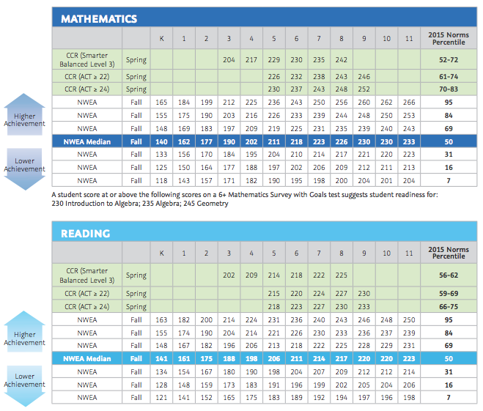
NWEA Tables of Comparative Data

