Slide 1
Secondary Math Department
GAA 2016-2017

Slide 2
Math Department Team
Secondary Curriculum Coordinator
Ms. Jen Parker: IB Math HL
j.parker_gaa@gemsedu.com
Ms. Kelli Baker: Algebra 1, IB Math Studies SL
Mr. Michael Palano: Geometry, IB Math SL
Ms. Laura Szafran : Pre-Calculus, IB Math SL, IB Math HL, Statistics
Secondary Mathematics Coordinator
Ms. Farah Sami : IB Math SL, IB Math Studies SL, Algebra II
f.sami_gaa@gemsedu.com
Mrs. Sarah Firestone: Math 6
Mr. Jonathan Yoon: Math 7
Ms. Tejal Bhatt: Pre-Algebra

Slide 3
GAA Math Curriculum
Based on
American Education Reaches Out (AERO) Common Core Plus
standards of learning
and the International Baccalaureate Diploma Programme (IBDP)
* Enrollment in courses is based on skill-readiness, not on age.*

Slide 4
GAA Math Curriculum
Our curriculum is considered an accelerated pathway
to prepare students for higher likelihood of success in IBDP
…
However, one size does not fit all

Slide 5
Secondary Math at GAA Pathways
Accelerated
Traditional
American
Gifted and Talented
Math 6
Pre-Algebra
Algebra 1
Geometry
Algebra 2
IBDP
Math 6
Math 7
Pre-Algebra
Algebra 1
Geometry OR Algebra 2
IBDP
Math 6
Math 7
Pre-Algebra
Algebra 1
Geometry
Algebra 2
PreCalculus or Statistics
Pre-Algebra
Algebra 1
Geometry
Algebra 2
PreCalculus
IBDP

Slide 6
Math in grades 11 & 12
IBDP
Standard Level Mathematical Studies
Standard Level Mathematics
Higher Level Mathematics
Non-DP
Algebra 2
Functions and Statistics Applications
Mathematical Analysis
Statistics
PreCalculus
Calculus

Slide 7
GAA Math Curriculum
“The standards themselves do not dictate curriculum, pedagogy, or delivery of content.
… For example, many students in the U.S. today take Algebra I in the 8th grade, and in some states this is a requirement. The standards (in grades 5‐7 at GAA) contain the prerequisites to prepare students for Algebra I by 8th grade.”
www.projectaero.org

Slide 8
Alignment of AERO standards
Math 6
Math 7
Pre-Algebra
Algebra 1
Geometry
Algebra 2
grade 6 and some of grade 7
grade 7
grade 8 and some of grade 7
numbers & number system, algebra, functions
geometry
numbers & number system, algebra, functions, quantities, data analysis & probability

Slide 9
Summer Studies
Doing online courses over the summer or outside of school is only recommended for students needing review.
We discourage doing courses outside of school resulting in skipping a “level”.

Slide 10
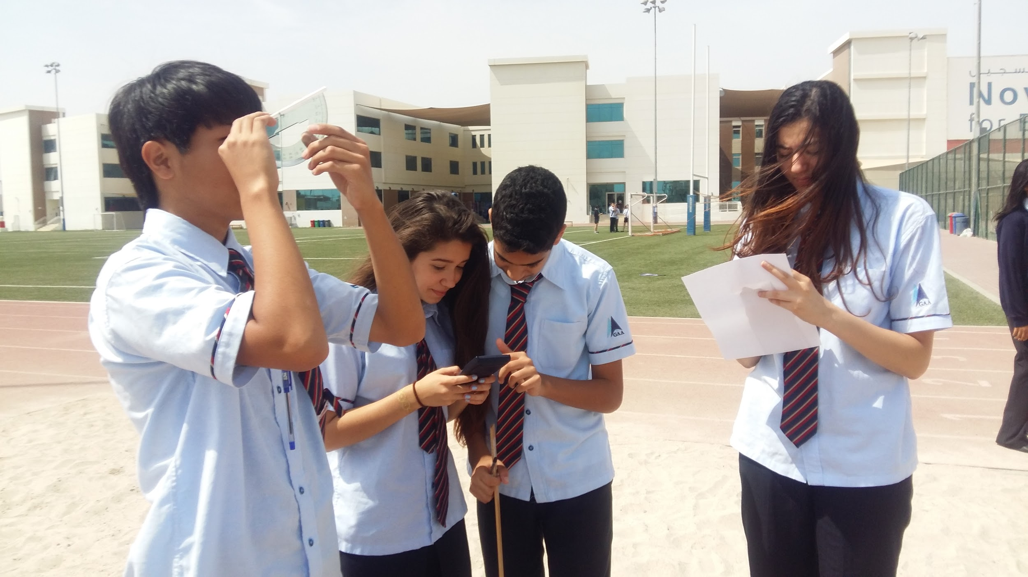
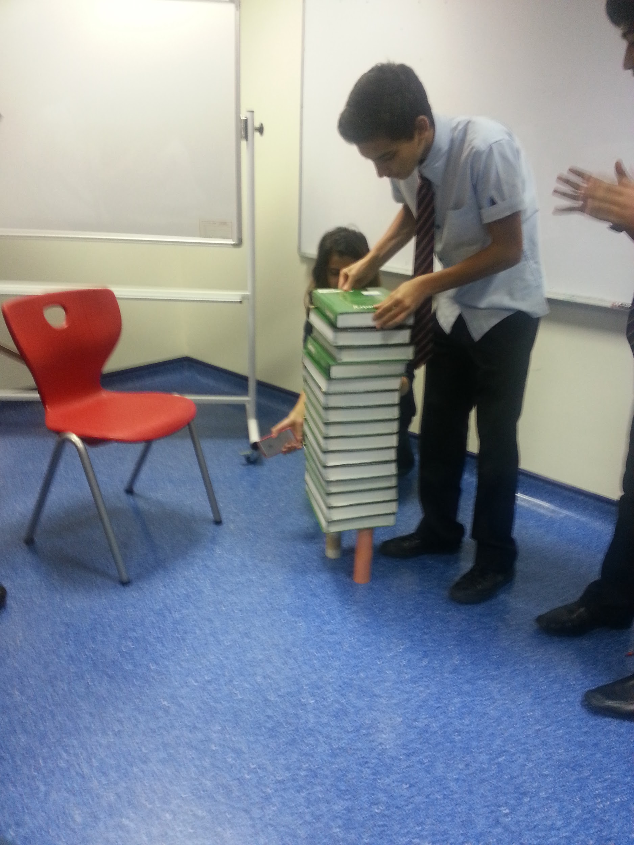
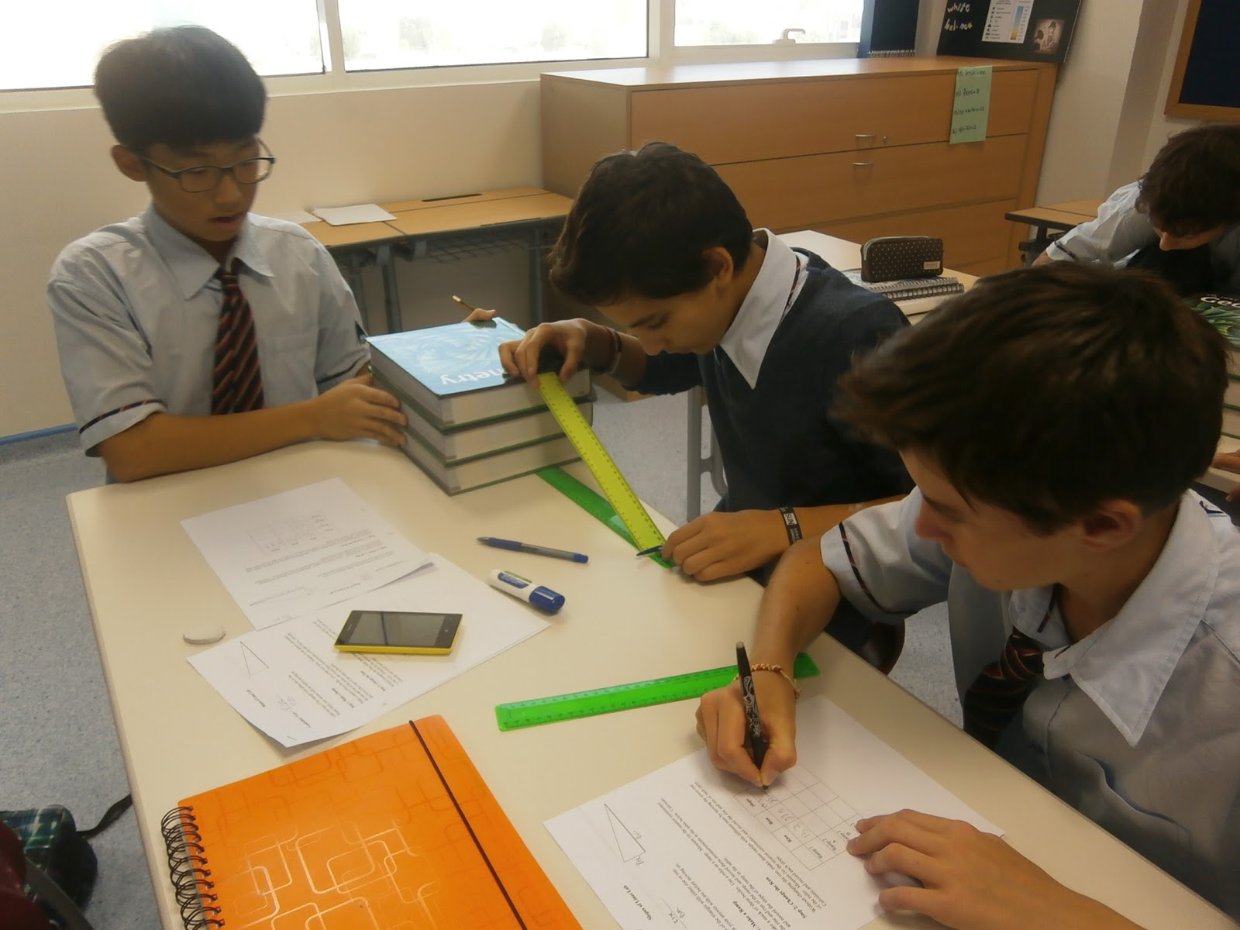
How we learn best?
Problem Solving
Reasoning (justifying answers)
Communication (modeling)
Connections - math in everyday life

Slide 11
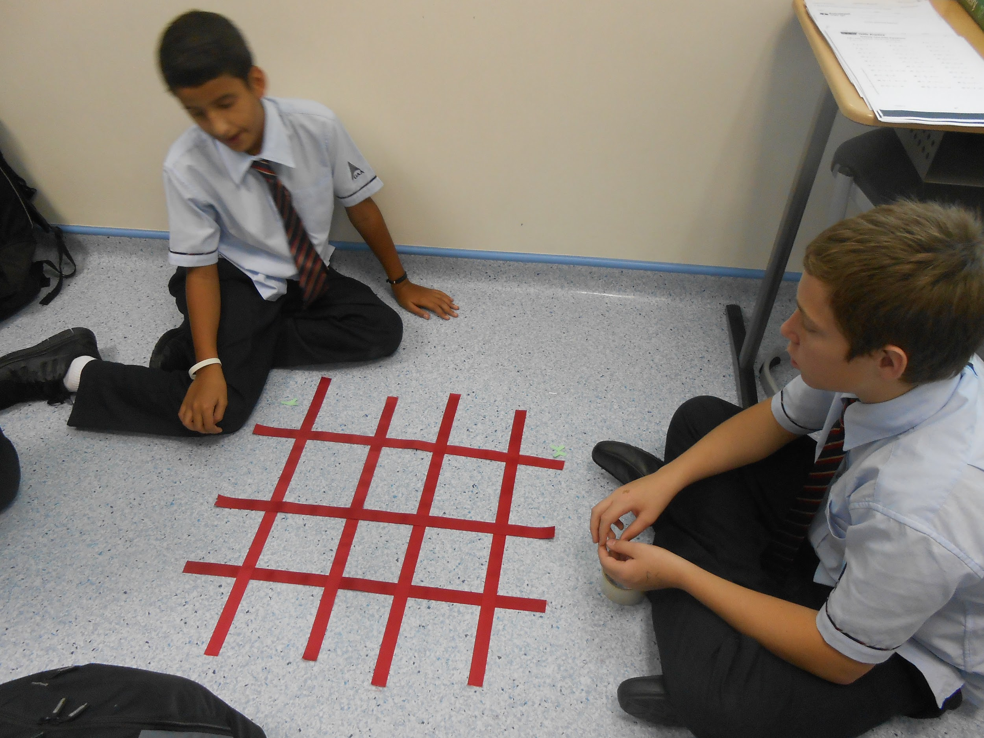
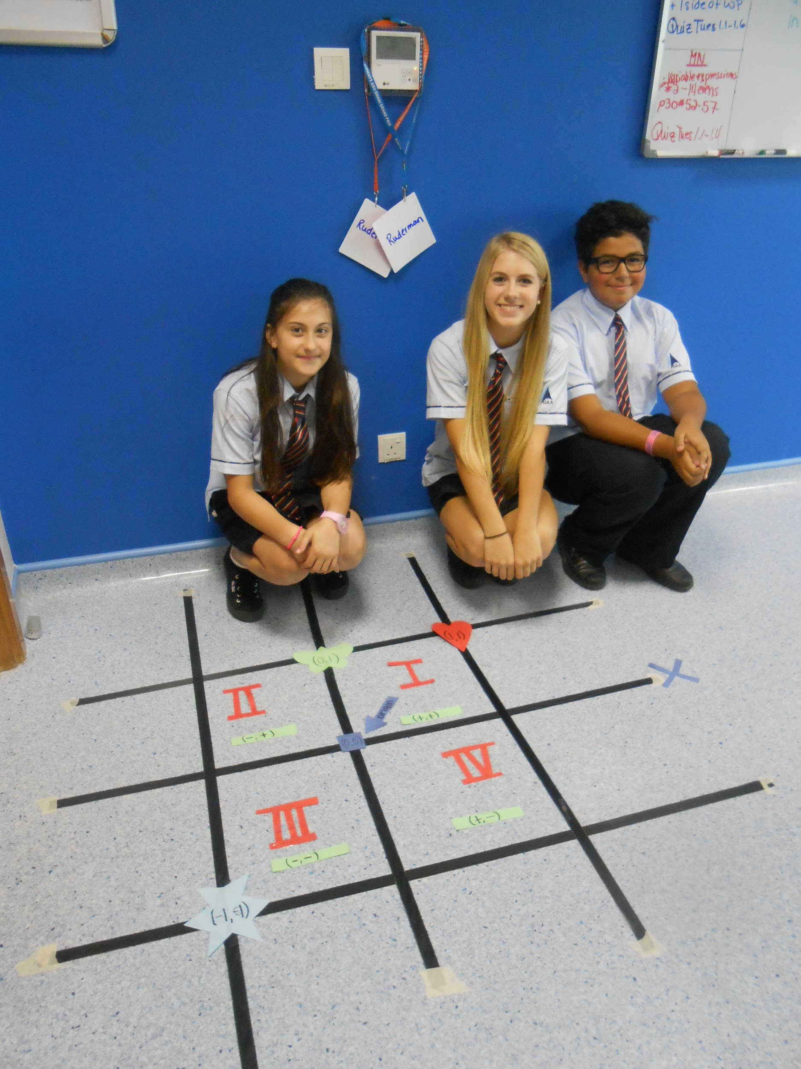
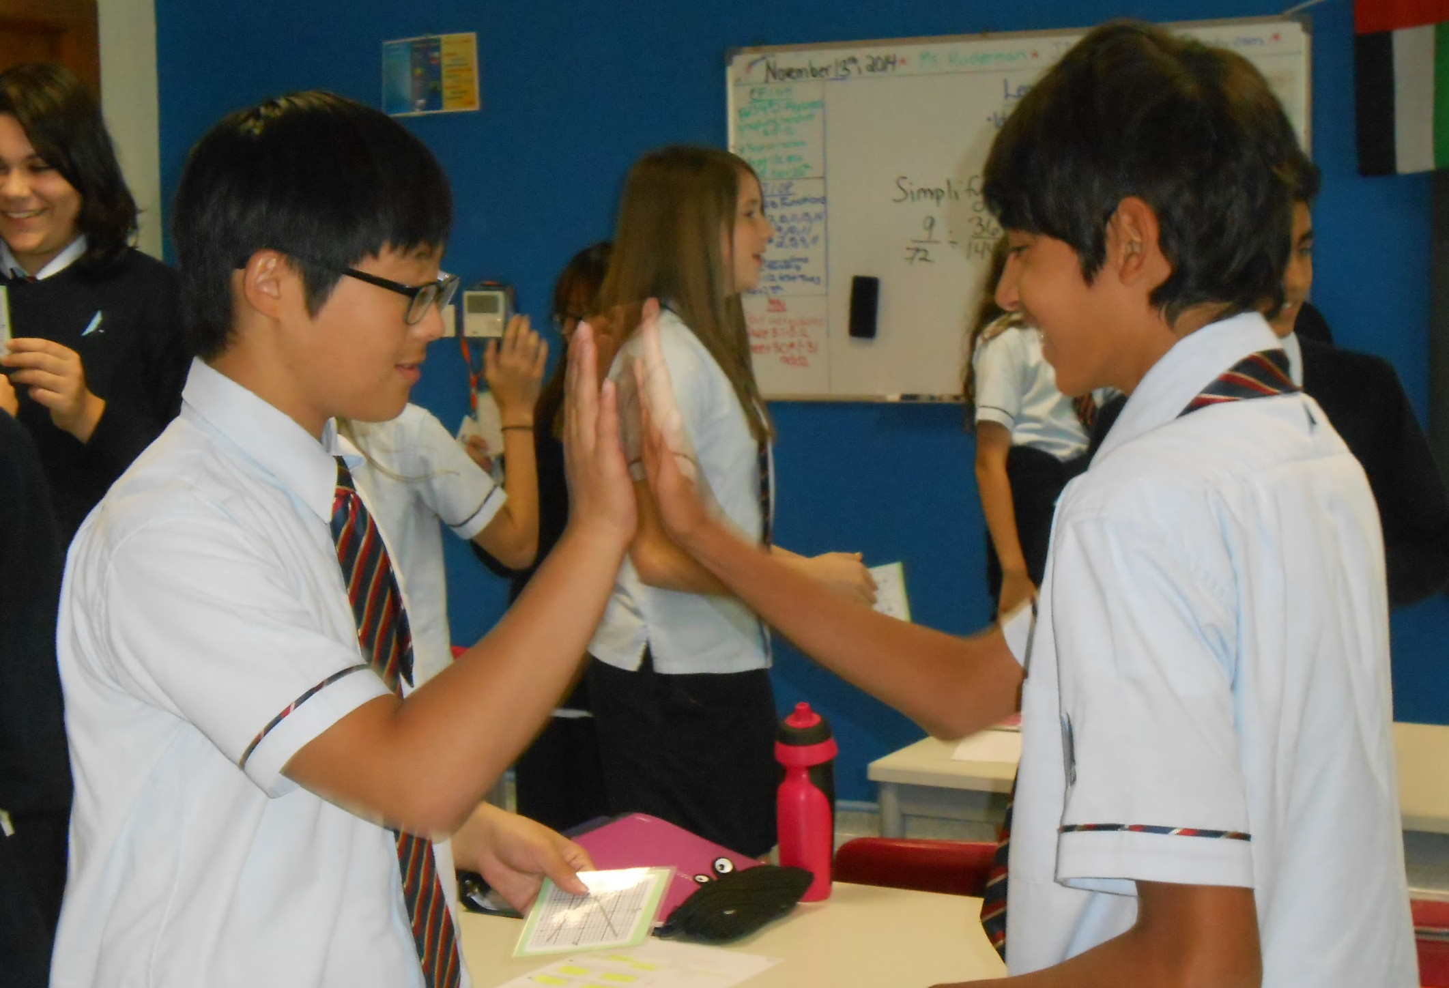
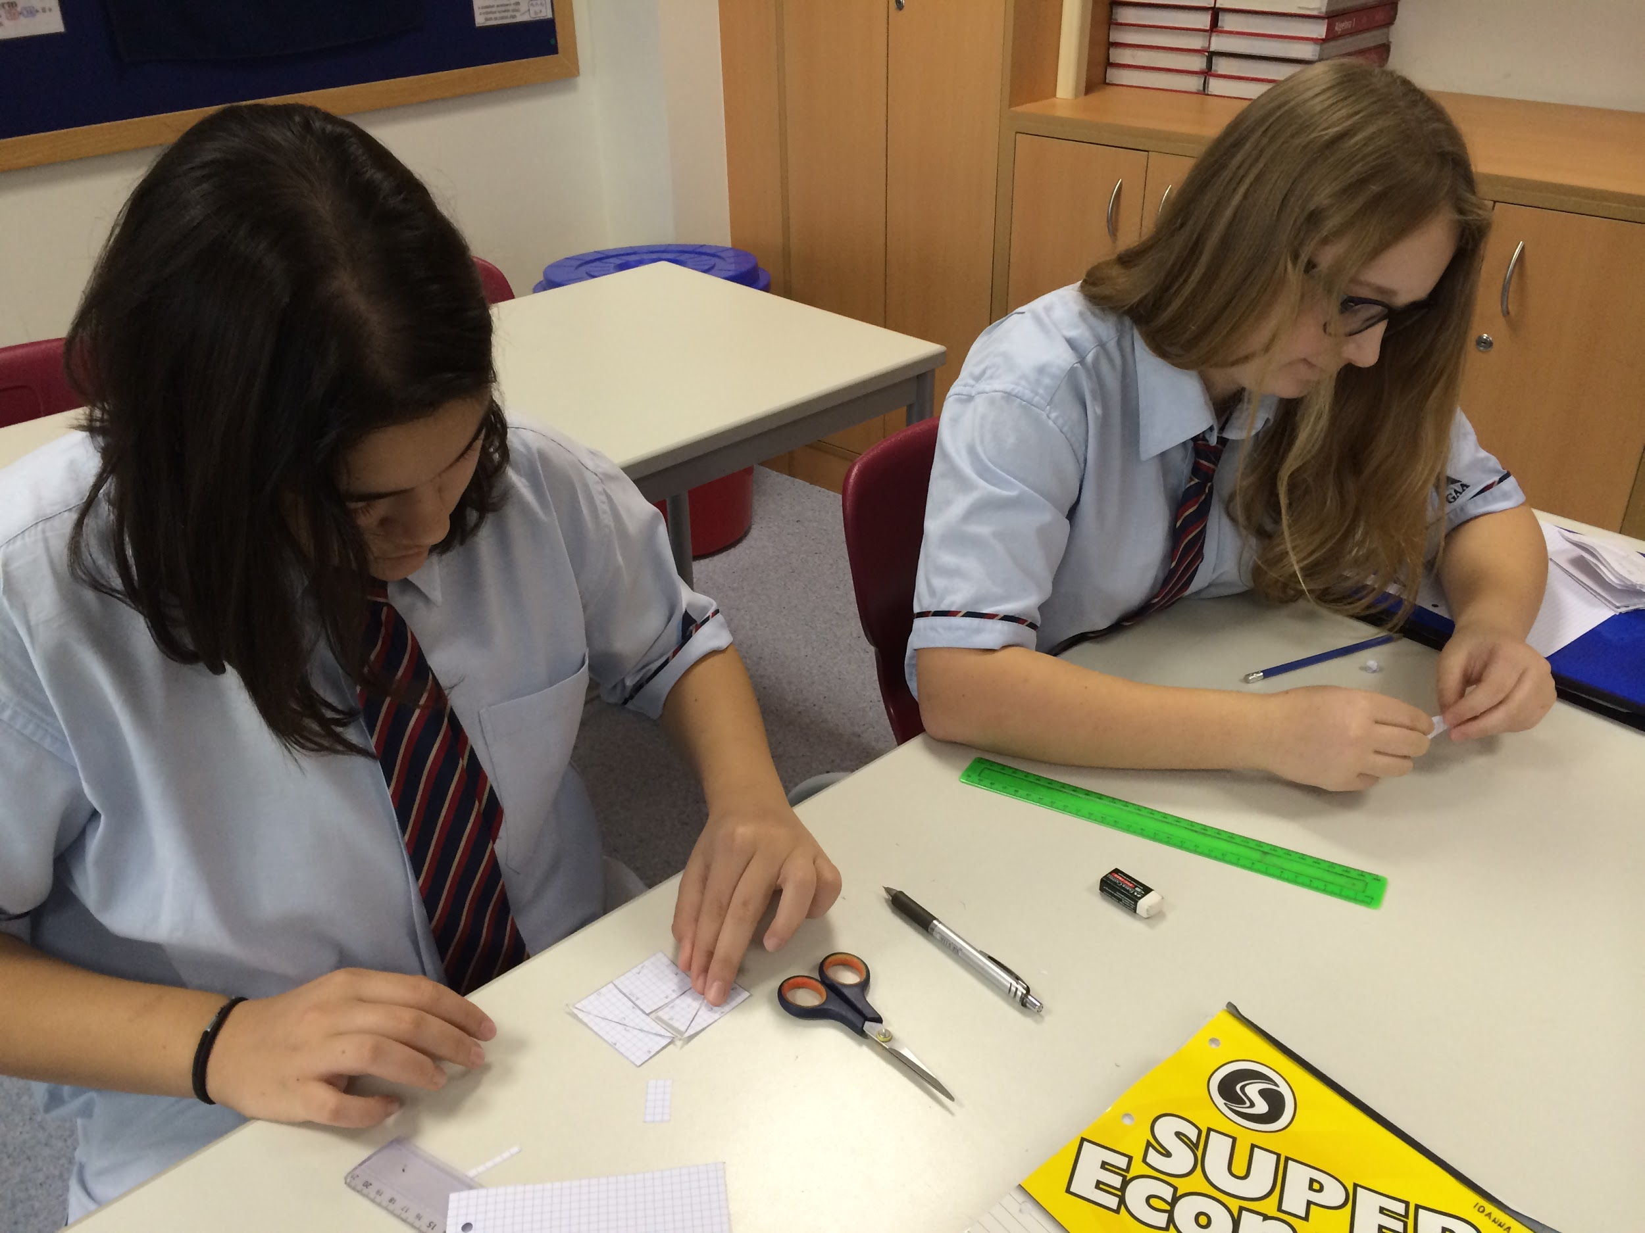
Learning
Group Work
Discussions (example:
Independent Practice
Guided Note Taking
Learning through Songs
Student-Centered Activities- Inquiry/Exploration (example:
Use of Technology (GDC, www.desmos.com, online practice, spreadsheets, etc.)

Slide 12
Math Department Assessment Policy
In Secondary Mathematics at GAA, we communicate both formative and summative assessments.
Summative assessments measure mastery of content and skills.
Summative assessments are reported using letter grades. The letter grade scale is criterion-based, aligned to our course standards.
Formative assessments provide feedback on how a student is progressing; they are not included in final grades.
Formative assessments are classwork, homework, and small quizzes.

Slide 13
Assessments (Criterion-Based)
Practice spot checks
Quizzes - skill-based
Quests - longer quizzes with more skills, and more knowledge
Unit Tests - assessment of multiple skills, knowledge and understanding
Projects/ Activities

Slide 14
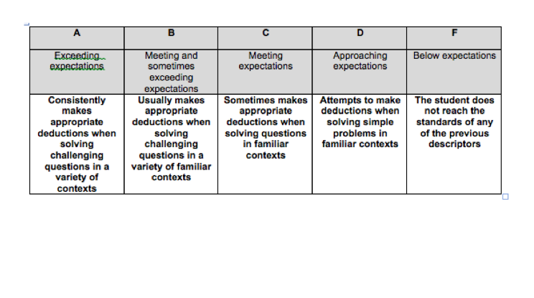
Grading Scale

Slide 15
Formative Assessments
Spot checks
Observations during class
Quizzes
Homework: Each homework will receive a score of 0, 1, or 2.
0: Incomplete/Needs improvement
1: Satisfactory/ Partially done/Decent effort
2: Complete with problems written out and work shown (does not necessarily mean it is all correct!)
If students have two 0’s in a row, require them to come in during lunch/recess until assignment is complete.
Does not count towards grade and student can make up missed assignments.

Slide 16
Late Policy on Summative Assessments
Tests: If a test is missed then the expectation is to take the test the next class as long as the student was present for the review class.
If you have missed days prior to the test coming up, please ensure to check Haiku for missed material to be prepared for the test.
If they were not present for class review, student has up to a week to make up the test in one sitting. Students should take the test during class time or set up a time with a teacher before or after school.

Slide 17
Calculator Policy
All students in Geometry, Algebra 2 and grade 10 and up are required to have an approved graphing display calculator.
Students are encouraged to buy the TI - 84 or TI - Nspire (non CAS).
The use of calculators is determined by the teacher/ nature of the problems.
Students in Algebra 1 are encouraged to have GDCs by the end of the year, especially older students. However, formal instruction on how to use them does not occur until later in the Algebra 1 curriculum.

Slide 18
Not enough homework? Looking for more practice?
www.ixl.com - free for about 20 minutes per day
www.khanacademy.org - online exercises as well as video tutorials
www.kutasoftware.com - free worksheets (with answers) for Pre-Algebra and up
www.mathopolis.com - online exercises according to content/ skill

Slide 19
Math Competitions
American Mathematics Scholastic Association (ASMA) - Held monthly at GAA, from October - March. Students must sign up ahead of time as there are a limited number of spots. Sign-up dates will be announced in classes. There is a Junior Division (Middle School) and a Senior Division (High School).
AMC 10 and AMC 12 - Held once per year at NYU-Abu Dhabi. GAA is permitted to bring a limited number of students. Selected students will be invited by their teacher. AMC 10 is for students grade 10 and below. AMC 12 is for students in grades 11 and 12.
There may be other competitions that we will be invited to throughout the year.

Slide 20
Thank you

